Slide 1
The Rise Of Disruptionware Debra Baker, vCISO

Slide 2
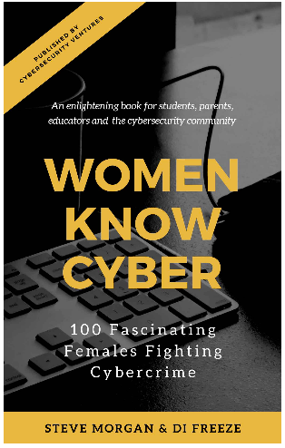
>whoami
Debra Baker, CISSP CCSP
20 years of practical experience in security starting in USAF > IBM > Entrust > Cisco > RedSeal
Founder of JHU Cryptographic Knowledge Base https://CryptoDoneRight.org
Distinguished SME in Information Security (ISC2)
Top 100 Women in Cybersecurity
Twitter: @deb_infosec

Slide 3
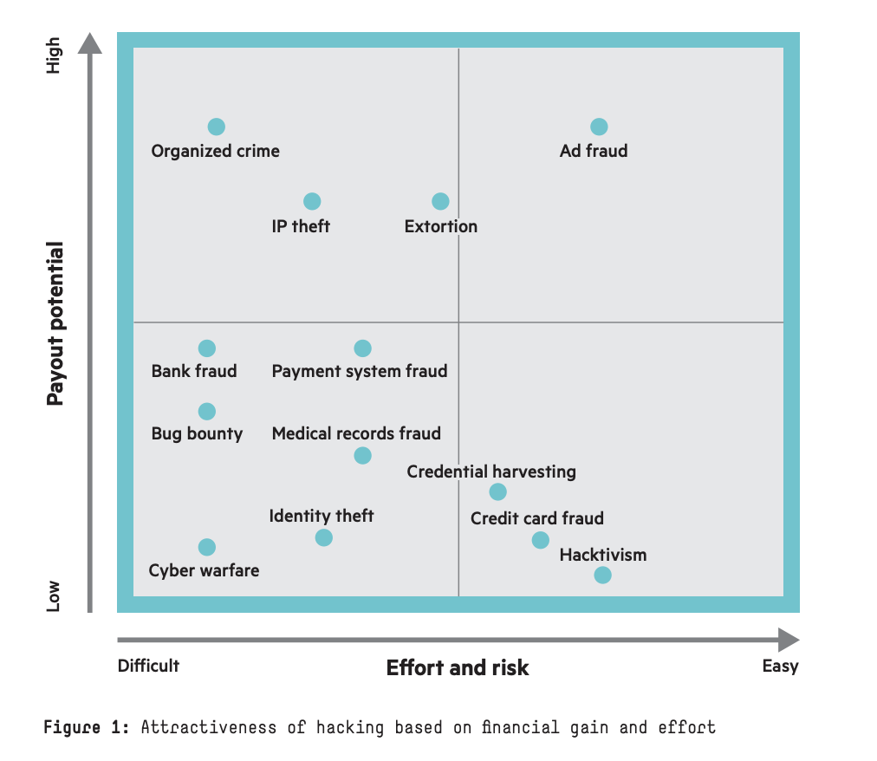
Hacking is Big Business
Cybersecurity Ventures predicts cybercrime damages will cost the world $6 trillion annually by 2021, up from $3 trillion in 2015.
Source: HPE The Business of Hacking
Notes:
https://cybersecurityventures.com/hackerpocalypse-cybercrime-report-2016/
https://www.forbes.com/sites/daveywinder/2020/02/13/the-fbi-issues-a-powerful-35-billion-cybercrime-warning/#590d292d187f
https://www.information-age.com/global-cybercrime-economy-generates-over-1-5tn-according-to-new-study-123471631/

Slide 4
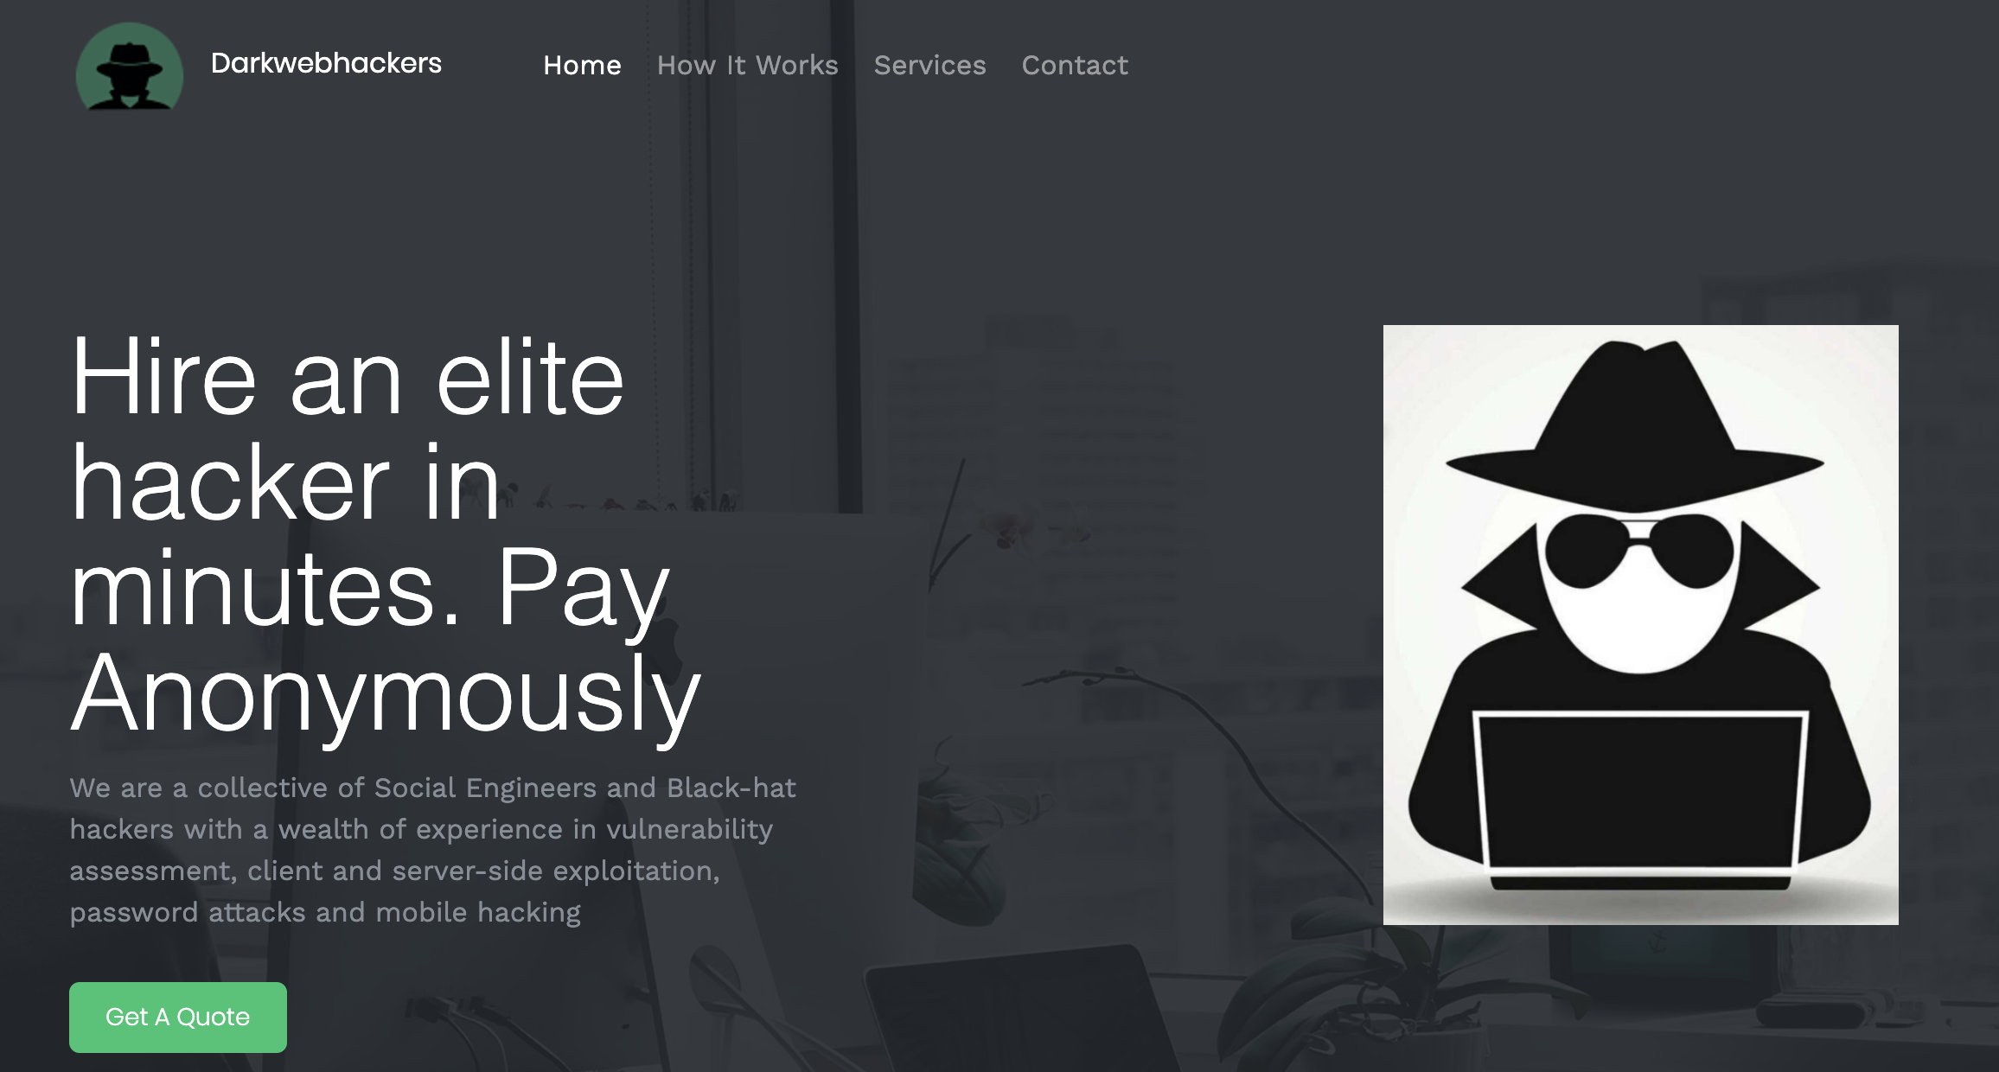
Threats
Anonymous
Easy
As a Service
CryptoPay
Nation State

Slide 5
What is Disruptionware?
Institute for Critical Infrastructure Technology (ICIT) defines disruptionware as a “new category of malware designed to suspend operations within a victim organization through the compromise of the availability, integrity, and confidentiality of the systems, networks, and data belonging to the target.”
Notes:
https://www.natlawreview.com/article/emerging-cyber-security-threats-2020-rise-disruptionware-and-high-impact-ransomware

Slide 6
What is Disruptionware?
In a Nutshell,
Sophisticated attacks
Halts an organization’s operations
Using a combination of known hacker tools
Ransomware
Network Reconnaissance Tools
Network mapping tools
Key loggers
Data Exfiltration
Wipers
Bricking Capabilities
Automated Components
Botnets
Credential Stuffing

Slide 7
Example Wiper Attack at Aramco
Shamoon (also known as Disttrack)
Email Phishing

Slide 8
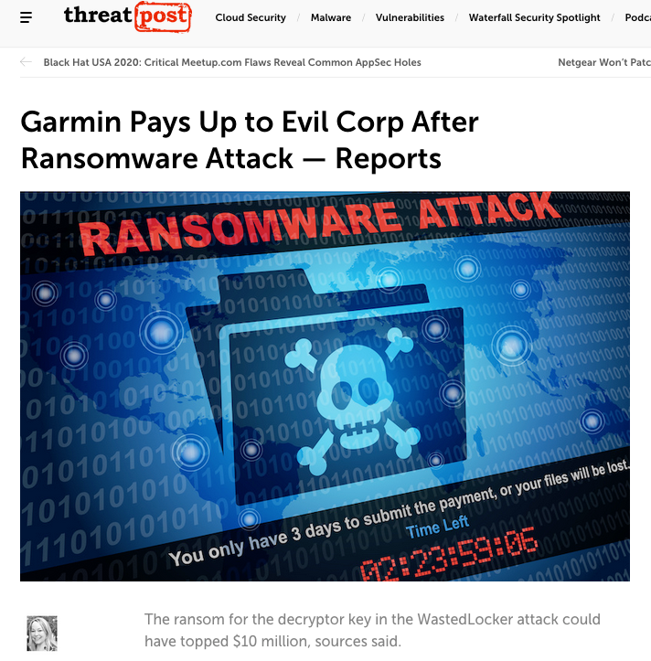
Garmin Ransomware Attack

Slide 9
Garmin Ransomware Attack - What happened?
Hit by WastedLocker Ransomware on July 23rd
WastedLocker used by a Russian hacking group, known as Evil Corp.
Many of their “online services were interrupted including website functions, customer support, customer facing applications and company communications,”
Garmin said it had “no indication” that customer data was accessed, lost or stolen. The company said its services are being restored.
The attack caused massive disruption to the company’s online services
Garmin Connect
flyGarmin
Notes:
https://techcrunch.com/2020/07/27/garmin-confirms-ransomware-attack-outage/. Down for over a week

Slide 10
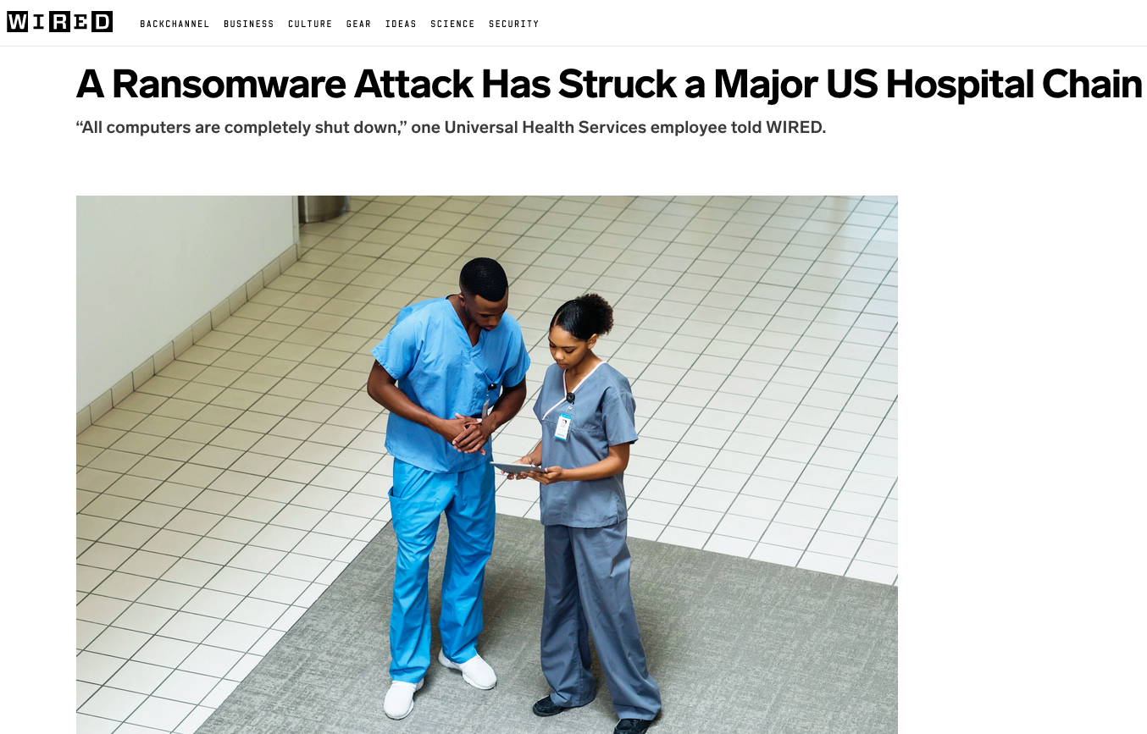
Large Scale Ransomware Attack at UHS
An emergency room technician at one UHS-owned facility tells WIRED that their hospital has moved to all-paper systems as a result of the attack.
Notes:
https://www.wired.com/story/universal-health-services-ransomware-attack/

Slide 11
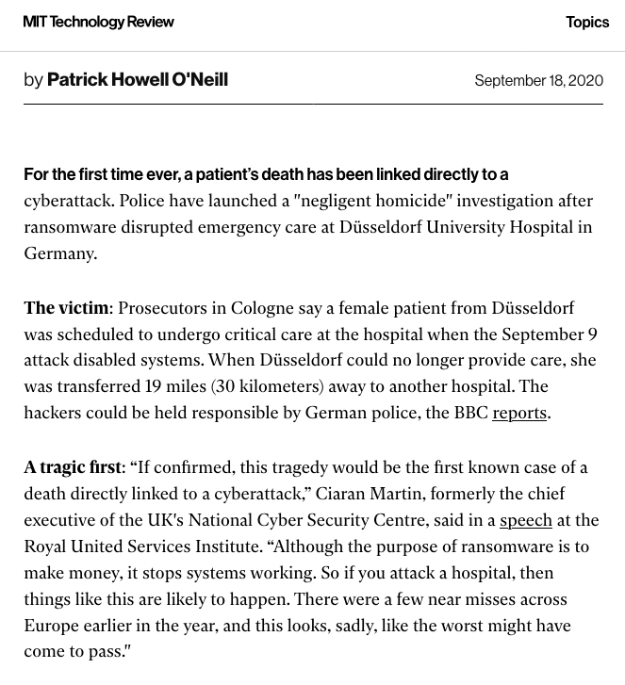
Ransomware Attack at German Hospital Leads to Death
German authorities say the hackers took advantage of a vulnerability in Citrix virtual private network software that was publicly known since January but which the hospital had failed to address.
Notes:
https://thehill.com/opinion/cybersecurity/519267-someone-died-because-of-ransomware-hospitals-emergency-security

Slide 12
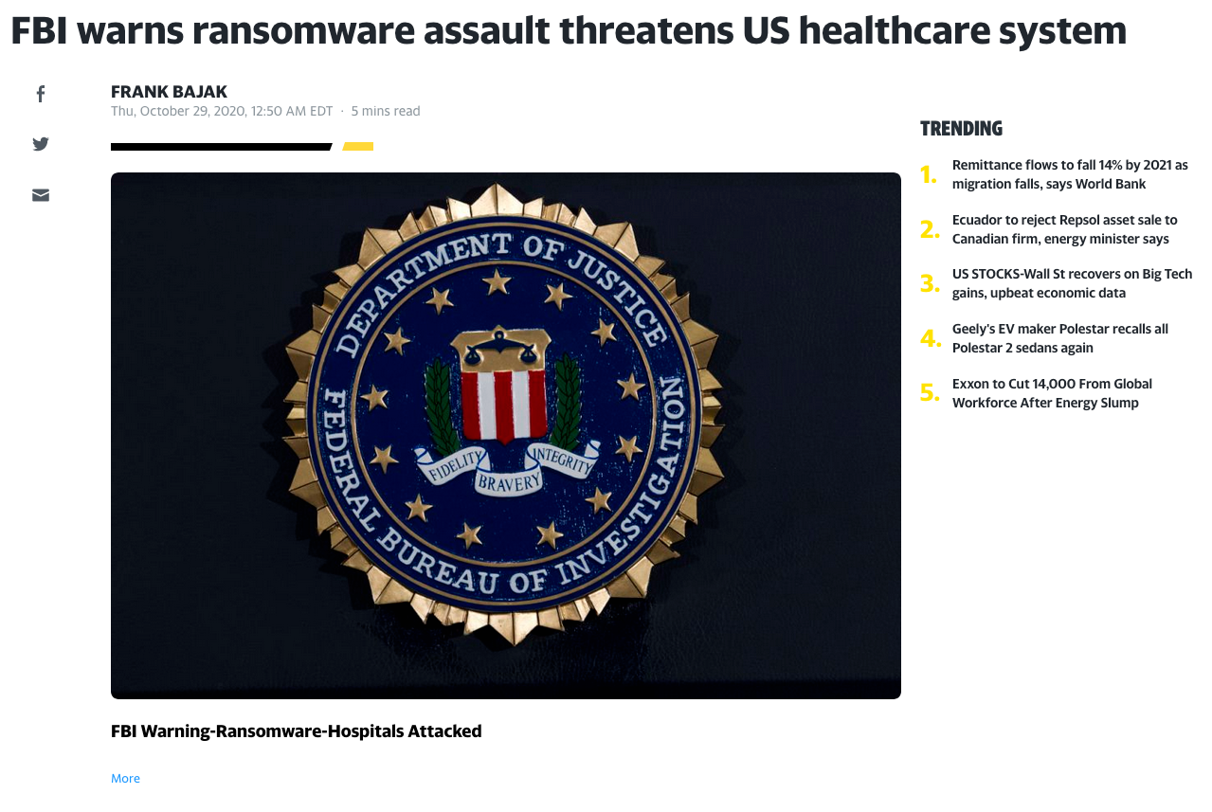
Notes:
https://thehill.com/opinion/cybersecurity/519267-someone-died-because-of-ransomware-hospitals-emergency-security

Slide 13
Ransomware Total Cost
Source: Cybersecurity Ventures
Notes:
https://cybersecurityventures.com/cybersecurity-almanac-2019/
https://www.gdatasoftware.com/blog/2018/02/30439-2017-ransomware-lessons-learned
https://info.deepinstinct.com/hubfs/Cyber_Threat_Landscape_Report_2019-2020.pdf
https://www.zdnet.com/article/ransomware-these-four-industries-are-the-most-frequently-attacked/
https://www.natlawreview.com/article/emerging-cyber-security-threats-2020-rise-disruptionware-and-high-impact-ransomware

Slide 14
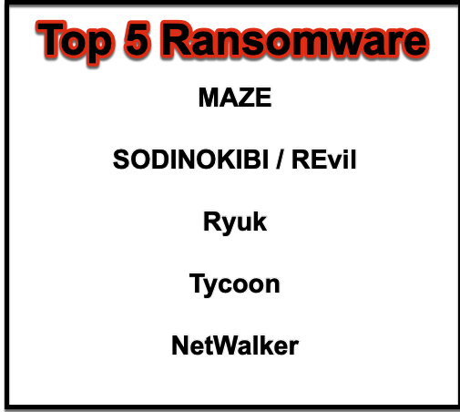
Top 5 Ransomware
Source: securityboulevard.com
Notes:
https://securityboulevard.com/2020/09/top-5-ransomware-attacks-to-watch-out-for-in-2020-2021/
https://info.deepinstinct.com/hubfs/Cyber_Threat_Landscape_Report_2019-2020.pdf

Slide 15
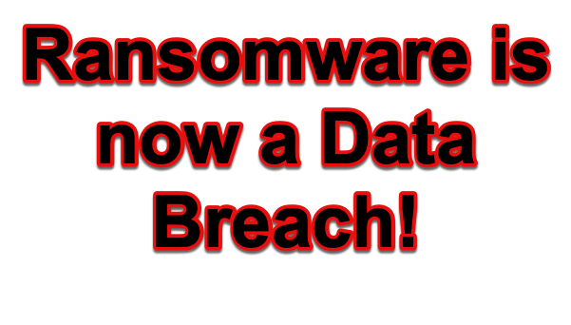
Top 5 Ransomware
Source: bleepingcomputer.com

Slide 16
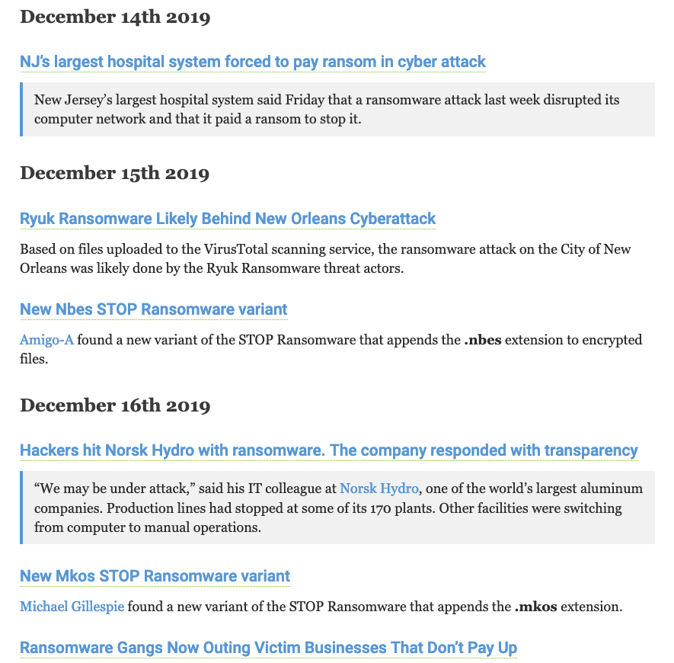
Notes:
https://krebsonsecurity.com/2019/12/ransomware-gangs-now-outing-victim-businesses-that-dont-pay-up/

Slide 17
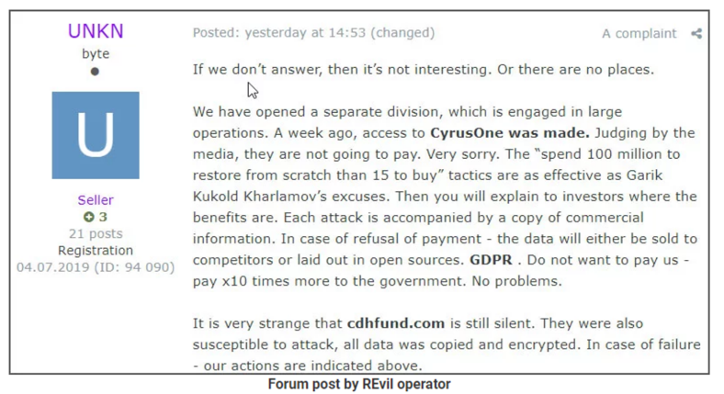
“Ransomware is Now a Data Breach” -BleepingComputer
The latest Ransomware (REvil) is sending the files to a remote server, so if you don’t pay the ransom, your data will be made publicly available.
Courtesy of Bleeping Computer

Slide 18
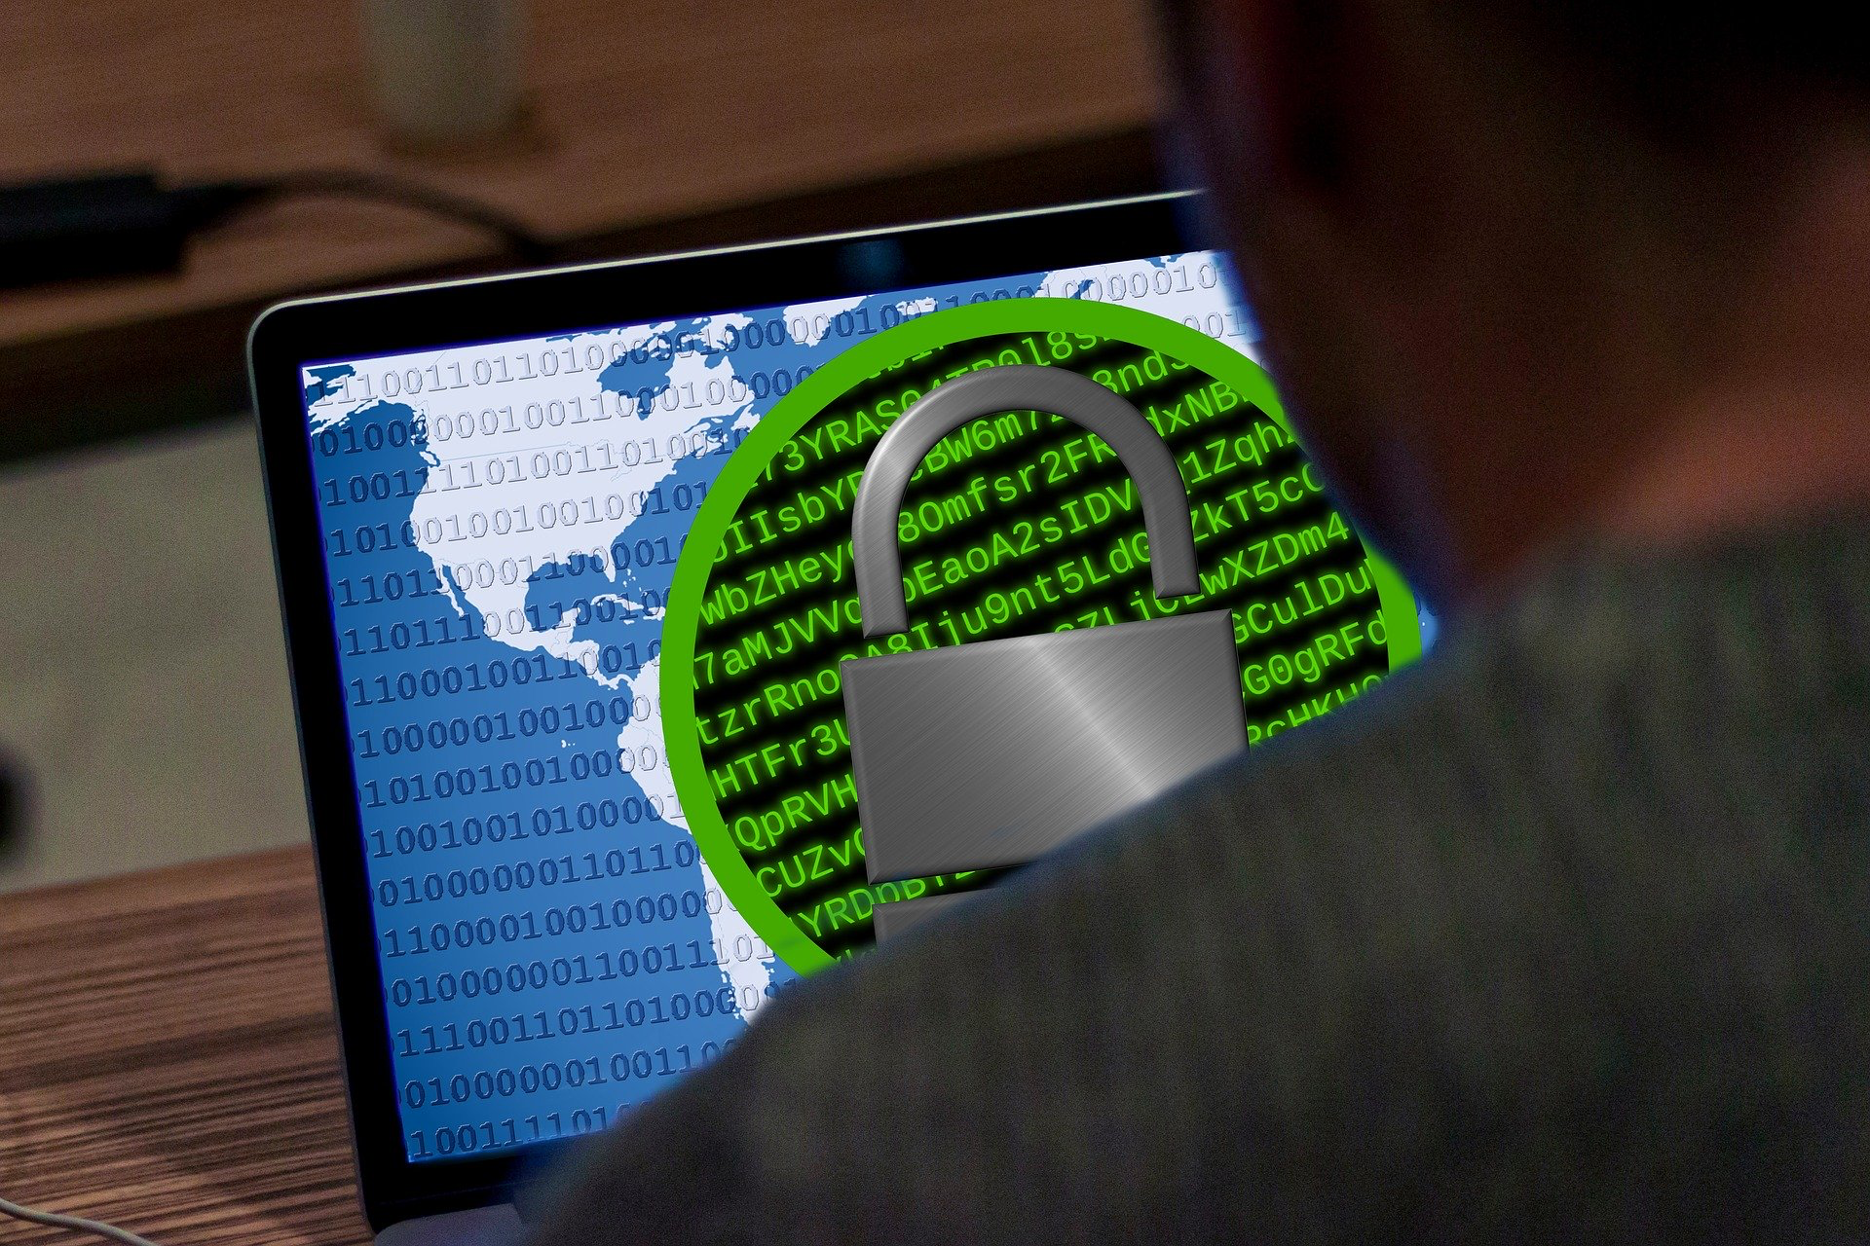
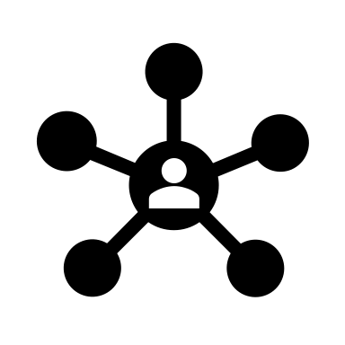
Anatomy of an Attack – Pre-2020
RDP
SMB
Disruptionware is a combination of tools to disrupt operations
Notes:
Go to site like Censys or Shodan to see RDP port 3389 or SMB exposed to the internet

Slide 19
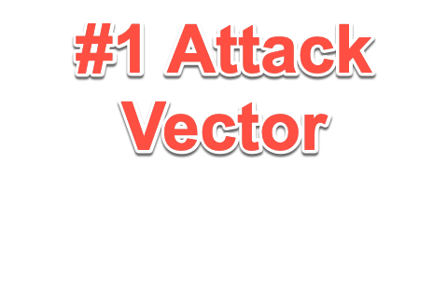
What is RDP?
Remote Desktop Protocol (RDP) – RDP is a client-server communication protocol developed by Microsoft. It provides a user with a graphical interface and RDP client to connect to another RDP server. RDP server software exists for Unix and OSX.
RDP
Port 3389
RDP Client
RDP Server
Notes:
Go to site like Censys or Shodan to see RDP port 3389 or SMB exposed to the internet

Slide 20
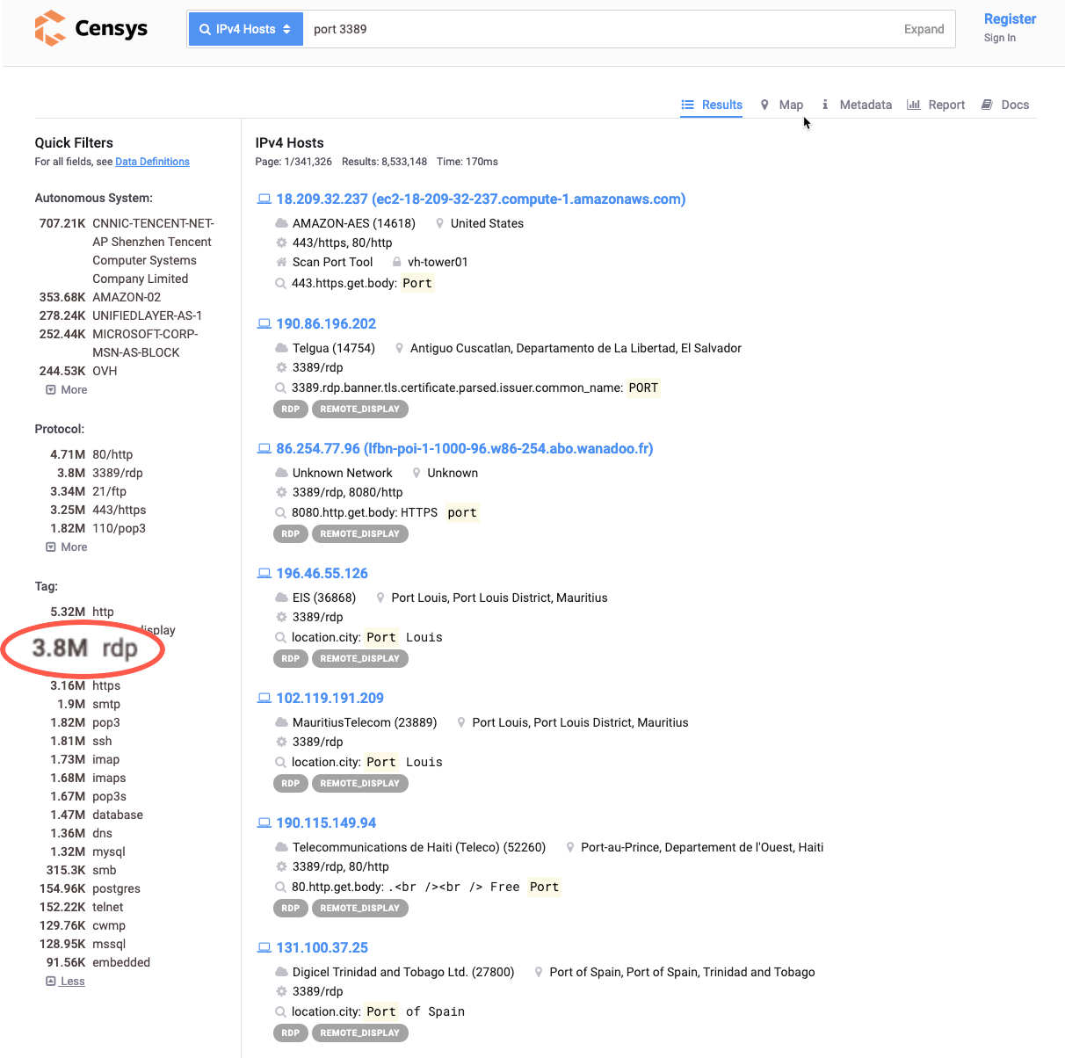
Censys.io Search port 3389 Exposed to Internet
How to Secure RDP
Use Strong Passwords
Use Two Factor Authentication
X.509 Certificates
Smartcard (Yubikey, RSA)
Block 3389 at Boundary Firewall
Limit Administrators who can login remotely;
by default all Admins have access
Notes:
Go to site like Censys or Shodan to see RDP port 3389 or SMB exposed to the internet

Slide 21
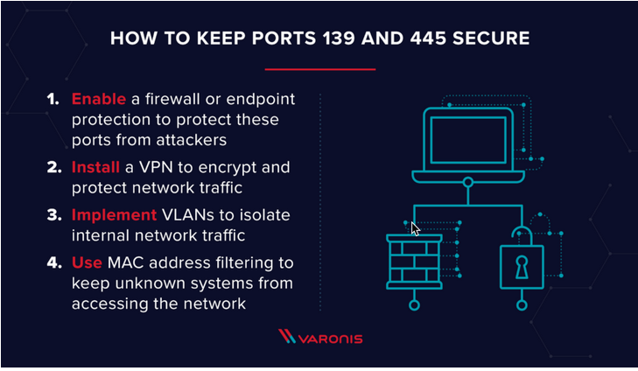
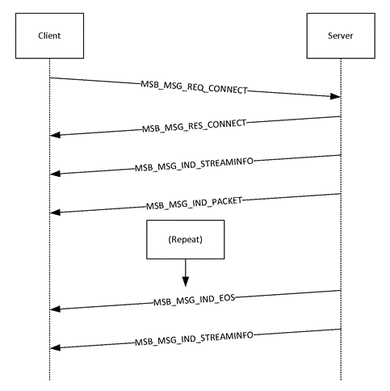
What is SMB?
Server Message Block (SMB) – SMB is a client – server communication protocol on port 445. Created by IBM in the 1980s, SMB is used for accessing shared resources such as printers, files, serial port and other resources on the network.
How to Secure SMB
Disable SMBv1.0
Use SMB 3.0 and above
Block TCP port 445 at Boundary Firewall
Block UDP ports 137-138 & 139 (NetBios)
Courtesy of docs.microsoft.com
Notes:
https://us-cert.cisa.gov/ncas/current-activity/2017/01/16/SMB-Security-Best-Practices
https://cryptodoneright.org/articles/standards/standards_table.html
https://www.varonis.com/blog/smb-port/

Slide 22
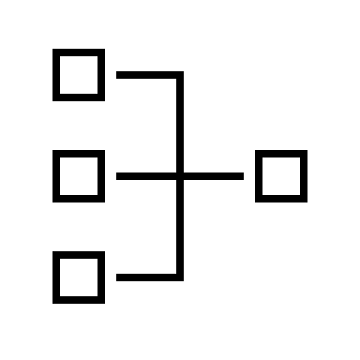
Anatomy of an Attack 2020
RDP
SMB
RDP
SMB
Notes:
Go to site like Censys or Shodan to see RDP port 3389 or SMB exposed to the internet

Slide 23
Ransomware – How to Protect Yourself
Scheduled Backups; Keep offline backups
Host Defender ie. Windows Defender, Crowdstrike, Tanium
Turn if off! Remove host from Wired and Wireless Network
Don’t use Windows 98, XP, Windows 7 and Windows Server 2008
No longer patched and frequently exploited.
Win 7 and 2008 stopped receiving security updates as of January 14, 2020
Turn off Remote Desktop Protocol (RDP) port 3389
Frequently exploited by Ransomware
Block port Ports 137-139, 445, & 3389 from external networks
Don’t use SMB 1.0, should be using SMB 3.0 >> WannaCry
If have SMB 3.0 in use, but have not disabled SMB 1.0, hackers could use SMB 1.0
Check well known site like nomoreransom.org which may have the decrypt key
https:// nomoreransom.org
https://www.barkly.com/ransomware-recovery-decryption-tools-search
Notes:
https://www.zdnet.com/article/poll-results-heres-why-people-are-sticking-with-windows-7/https://www.nomoreransom.org/en/about-the-project.html
According to data released today by Kaspersky Lab, roughly 98 percent of the computers affected by the ransomware were running some version of Windows 7

Slide 24
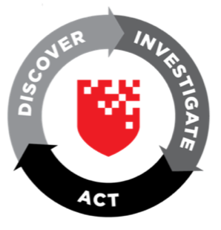
How to Protect Your Network? Get Back to the Basics
Multi-factor Authentication (MFA)
EDR
Multi-Factor Authentication
Know Your Network
Network Inventory (Solarwinds)
Discovery (RedSeal)
Segmentation (RedSeal)
Identify Your Critical Assets
Place High Value assets in high security segments
Vulnerability Management
Vulnerability Prioritization with Network Context (RedSeal)
Secure Configuration Network Devices
Center for Internet Security (CIS) (RedSeal)
STIGS (RedSeal)
Data Protection
Strong Cryptography
“Research from Gartner suggests that, through 2020, 99% of firewall breaches will be caused by simple firewall misconfigurations, not flaws.”
-Infosecurity Magazine

Slide 25
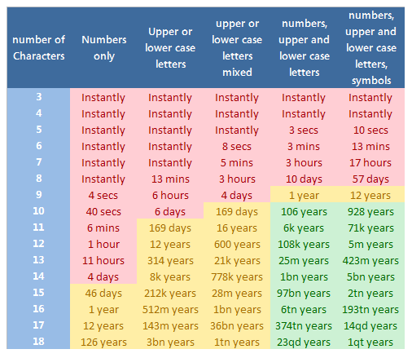
Identity and Access Management
“Almost every phishing attack that we’ve seen could have been prevented with multifactor authentication” Rory Sanchez, CEO of True Digital Security
Multi-factor Authentication
Strong Passwords
Use Special characters
Minimum of 12 characters recommended
Upper and Lower Case
Numbers
Training awareness
Use Argon2id for password hashing
Courtesy of Troubleshooting Windows 7 Inside Out
Notes:
https://www.channelpronetwork.com/article/making-work-home-security-work
https://www.betterbuys.com/estimating-password-cracking-times/
https://www.inetsolution.com/blog/june-2012/complex-passwords-harder-to-crack,-but-it-may-not
https://www.ghacks.net/2012/04/07/how-secure-is-your-password/

Slide 26
Identity and Access Management
Not a good idea to not force a password change until breach
Check against commonly used password lists > Have I have been pawned site
NIST 800-63B says only force new password when known breach occurs
Character and numbers only
Change user passwords at least once every 90 or 180 days
A 2010 study by Weir et al. found that users will simply capitalize the first letter of their password and add a “1” or “!” to the end, making the password no harder to crack. Any password cracker worth their salt knows about these patterns and has adjusted their tools accordingly.
Notes:
https://auth0.com/blog/dont-pass-on-the-new-nist-password-guidelines/
https://www.troyhunt.com/introducing-306-million-freely-downloadable-pwned-passwords/

Slide 27
Auditing
Audit Logs > Security Information and Risk Management (SIEM) ie Splunk
Individual User Access to PII data
All actions taken with root or Administrator access.
Access to all audit logs
Invalid logical access attempts
Entering incorrect password
Trying to access a file you aren’t authorized to access
Trying to access a folder you aren’t authorized to access
Notes:
Argon2 password storage

Slide 28
Back to the Basics: Asset Management & Discovery
Why it Matters?
Any endpoint open to internet could have an open port, unauthorized protocol, or vulnerability allowing access into your network
Leapfrog into other areas of your network
Marriott
Equifax
Capital One > $80 million fines
Managing hardware, software, and ephemeral devices
Service Now
SolarWinds
Axonius – Ephemeral
RedSeal – Discovery

Slide 29
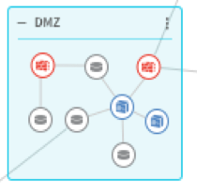
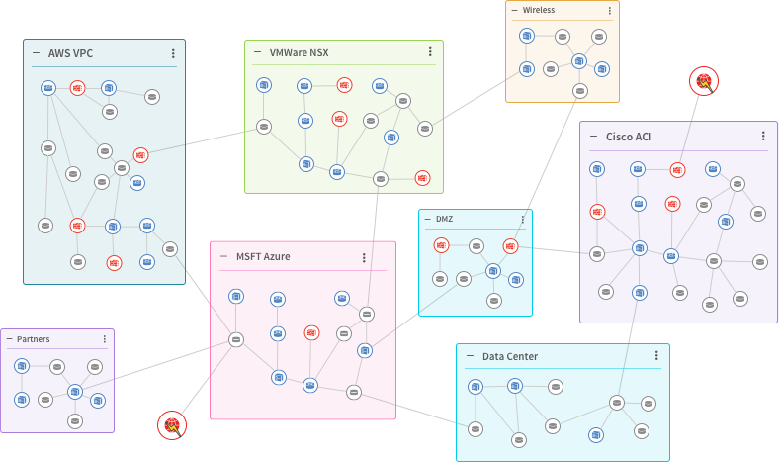
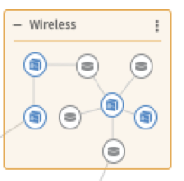
Prioritize Host Vulnerabilities Based on Network Context
Has access to critical assets
With RedSeal
No access to critical assets or untrusted networks
Remediation Order:
1.
2.
3.
4.
CVSS 9
CVSS 7
CVSS 7
CVSS 6
CVSS 7
CVSS 9
CVSS 4
CVSS 9
CVSS 6
CVSS 6
Is a critical asset
Exposed to untrusted network
CVSS 4
CVSS 4
Notes:
Vulnerability Management
At its core, the way RedSeal works is to fetch and normalize all configurations, access rules, and routes across all Layer 3 (routers) and Layer 4 (gateways, firewalls) devices as well as software-defined network fabrics on premise or in the cloud.
RedSeal also ingests vulnerability scan data and then undertakes the computationally intensive analysis of building a model of the network including all existing access paths, routes, including vulnerabilities and compute risk scores based on the exposure and downstream risk.
This model can then be queried in real time to answer a multitude of questions relevant to Network Operations, Vulnerability Management, Global Risk & Compliance, and the Security Operations Center. Ultimately, RedSeal can:
Creates a functioning network model
Allows you to identify your zones
Calculates all access paths from any point to any other in the network
Includes identified vulnerabilities and issues
Identifies the ones that are most critical for remediation

Slide 30
Top Remote Code Executable Flaws 2020
China 25 – NSA publishes top 25 exploits
Citrix Netscaler CVE-2019-19781
Windows RDP Exploit (aka Bluekeep) CVE-2019-0708
Windows Zerologon CVE-2020-1472)
Cisco ASA & FTD High Severity Security Flaw CVE-2020-3452
Cisco Jabber for Windows CVE-2020-3495
Cisco CDP CVE-2020-3119
Palo Alto VPN security flaw CVE-2020-2021
US Cyber Command has warned that nation states will exploit it
Palo Alto Buffer Overflow when Captive Portal or MFA enabled CVE-2020-2040
Windows aka Bad Neighbor CVE-2020-1656

Slide 31
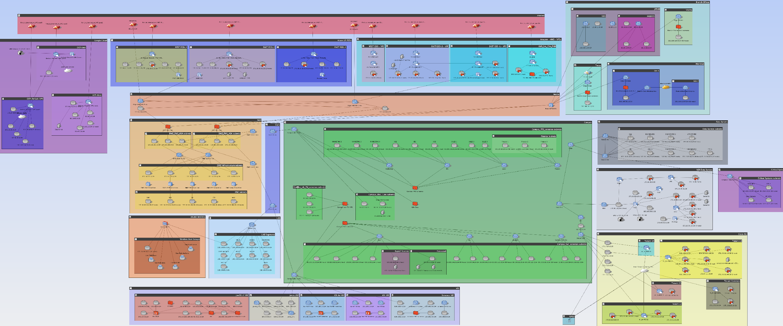
Understand Your Hybrid Environment
Internet
AWS
Azure
GCP
DMZ
On Premise
NSX
ACI

Slide 32
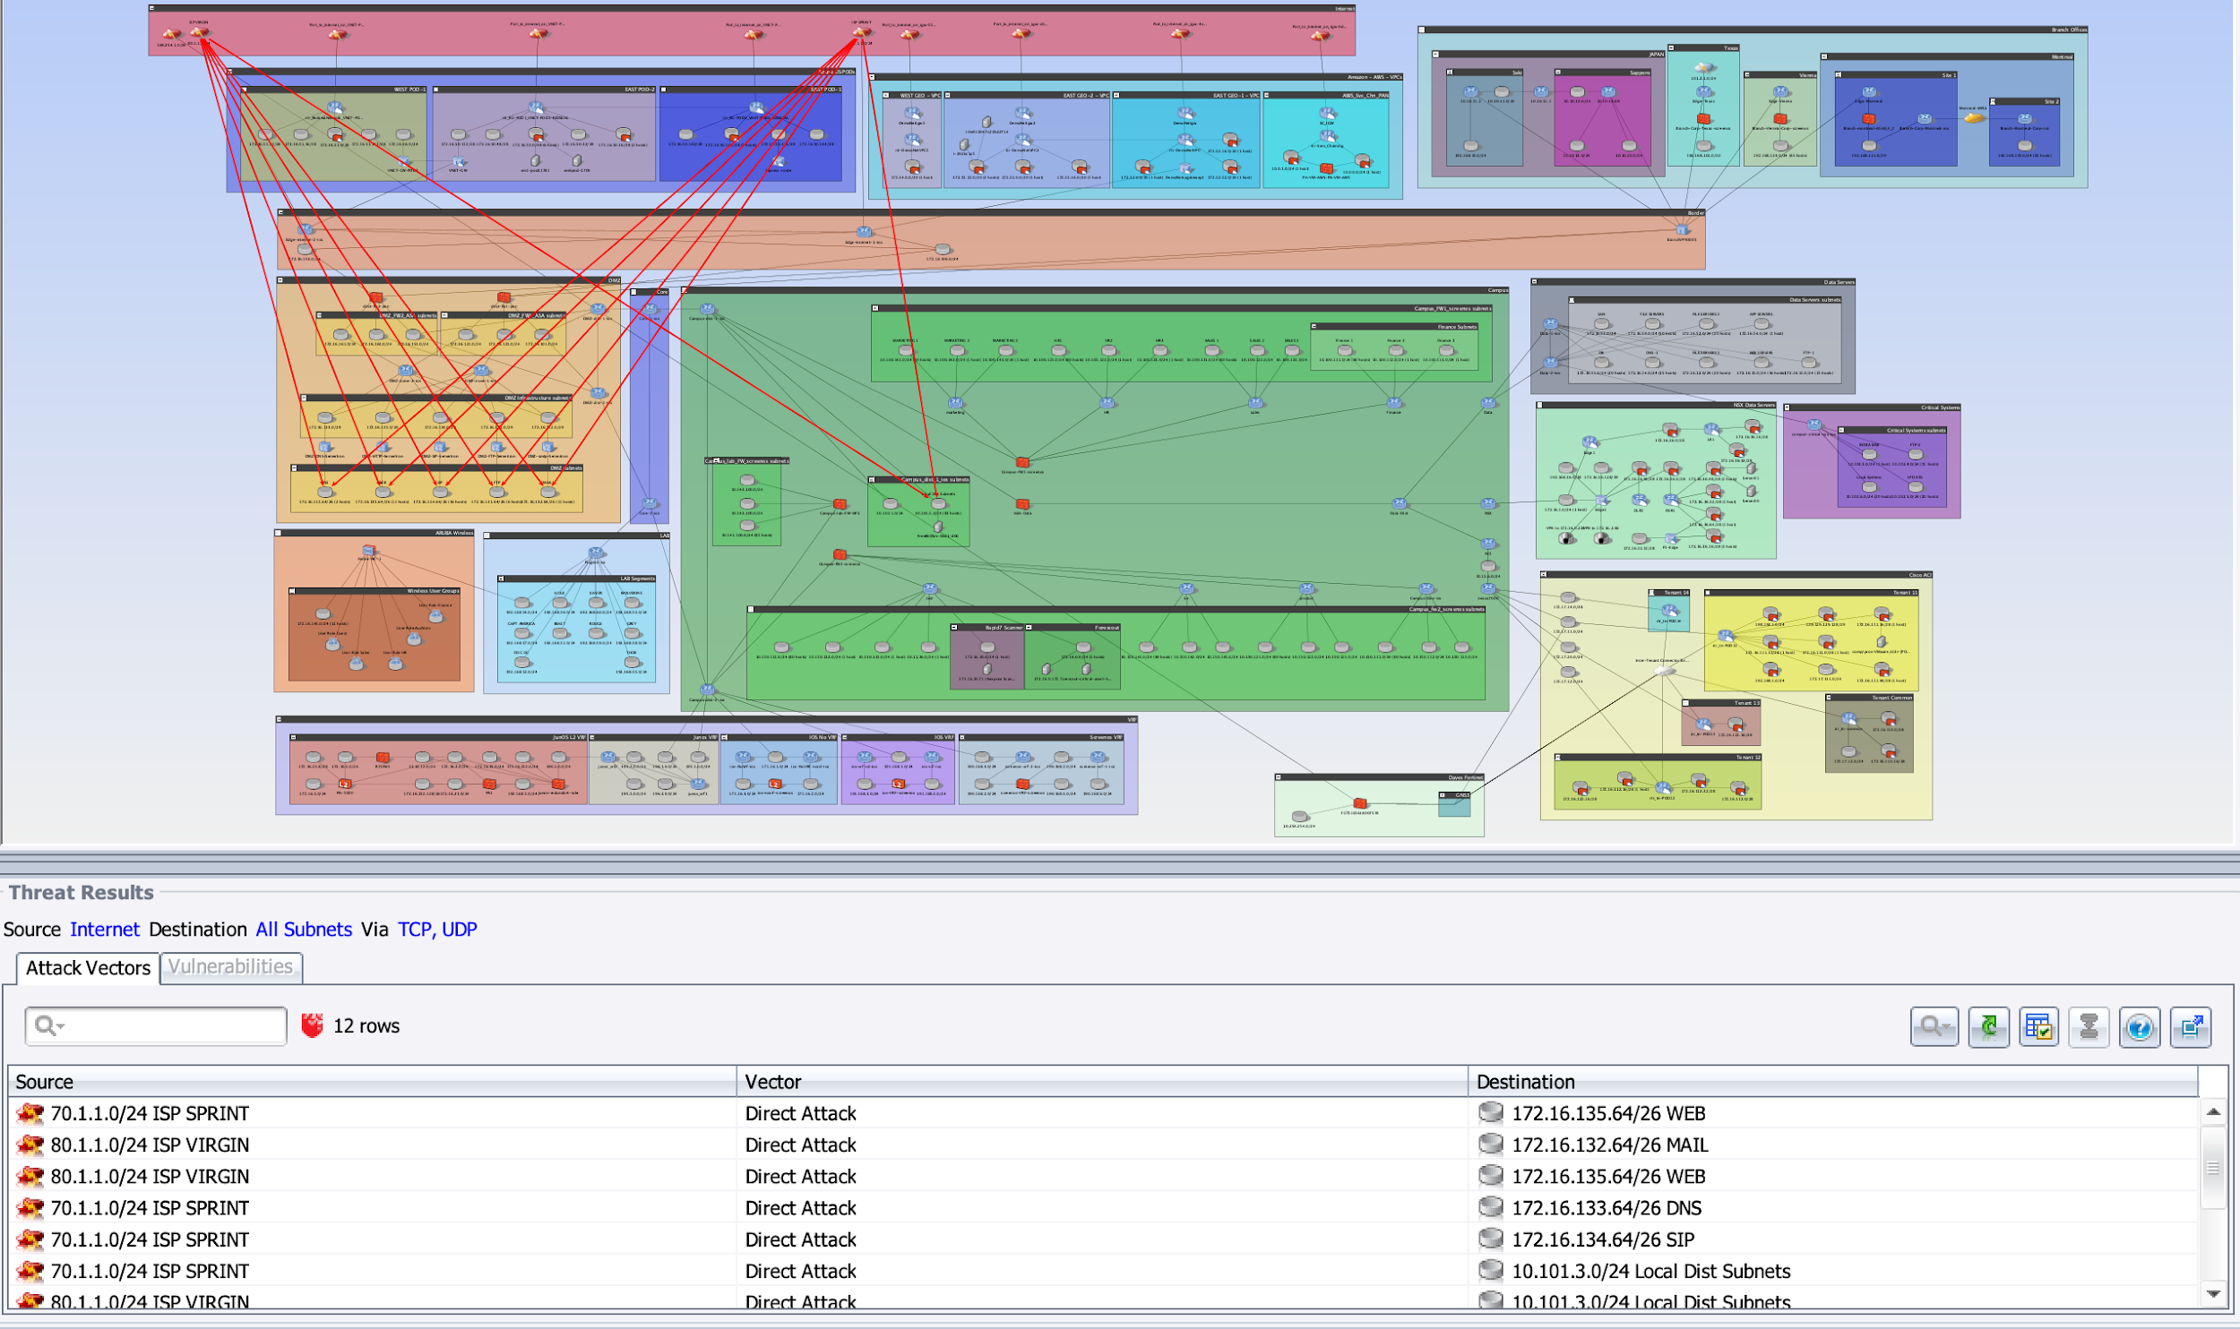
RedSeal Provides… Digital Twin of Network
Notes:
https://www.infosecurity-magazine.com/opinions/to-err-is-human-to-automate-divine/

Slide 33
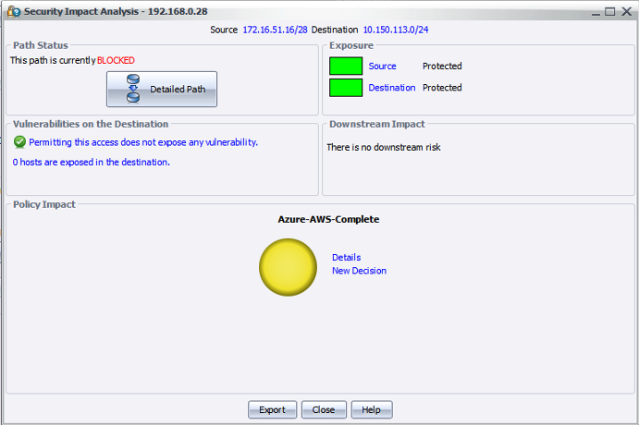
Security Impact Queries - Testing Changes Prior to Approval
By running a Security Impact Query:
Reviewers can see that no exposure would be created, and there is no downstream risk from this request
However, a policy would need to be updated to reflect an allowable change.

Slide 34
Cyber Compliance – Network Segmentation
Build network “digital twin”
Model across on-premise, cloud, and hybrid cloud Validate network segmentation for PCI Create PCI/Custom Zones and Policies Assess risks related to network and firewall changes
Policy for access to personal info – From User Zone A
Approvals required
Internet
All access forbidden
Azure Zone A
(No Personal Info)
Server Zone A
(No Personal Info)
Azure Zone B
(Internal Personal Info)
User Zone A
Server Zone B
(Internal Personal Info)
Azure Zone C
(Customer Personal Info)
Server Zone C
(Customer Personal Info)
Test Segmentation and send alert if out of compliance and send an alert
Notes:
What value should your customer be
receiving from your team or solution at each stage? Add a short description of this
experience below the column heading.

Slide 35
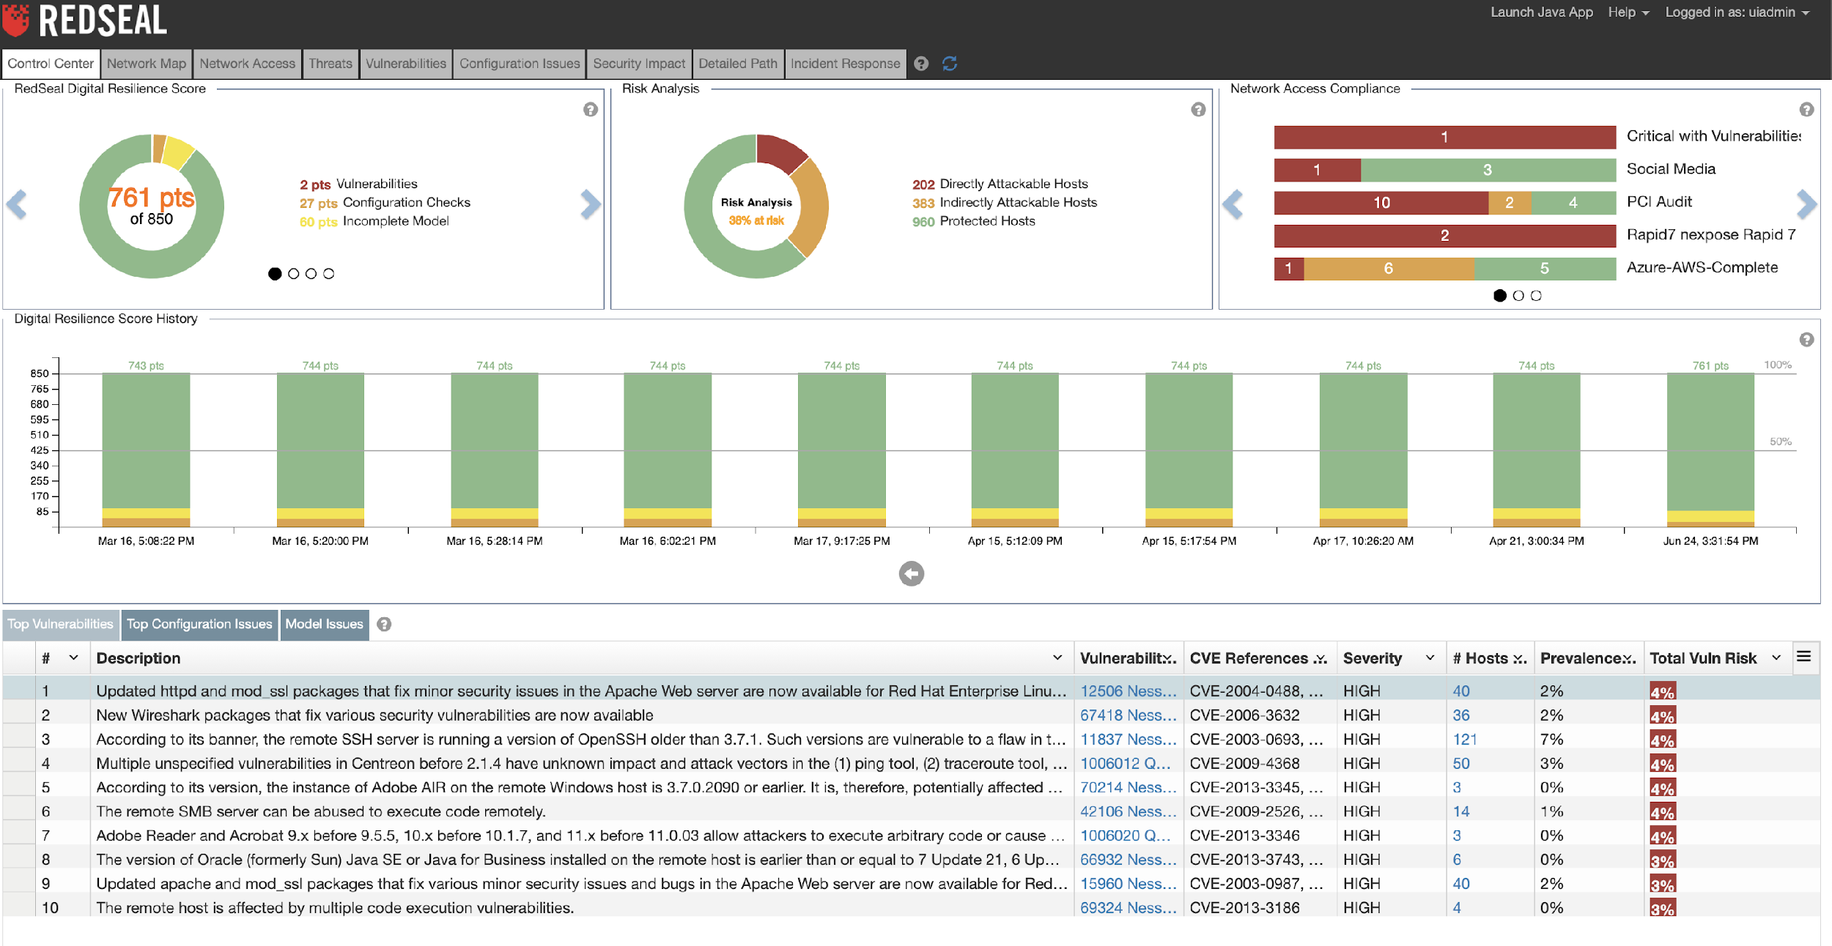
Risk Management – Prioritize Risks and Monitor Secure Posture
Risk Management
Rank vulnerabilities, identify system/network misconfigurations by risk in reference to their exposure to threats
Filter vulnerabilities based on network context
Notes:
Argon2 password storage

Slide 36
Data Protection – Use Strong Cryptography
Use Latest OpenSSL >
Note: The latest stable version is the 1.1.1 series. This is also our Long-Term Support (LTS) version, supported until 11th September 2023. All older versions (including 1.1.0, 1.0.2, 1.0.0 and 0.9.8) are now out of support and should not be used. Users of these older versions are encourage to upgrade to 1.1.1 as soon as possible.
TLS v1.2 or above is recommended
TLSv1.3 - Best
Hmac-sha-1 and above
SHA-2 and above
See Standards Table on Crypto Done Right for a Complete Listing of recommended ciphers https://cryptodoneright.org/articles/standards/standards_table.html

Slide 37
References
https://www.ibmsystemsmag.com/Power-Systems/03/2020/Ransomware-Attacks-on-the-Rise
Decryption Key Websites:
https://www.barkly.com/ransomware-recovery-decryption-tools-search
https://nomoreransom.org
https://id-ransomware.malwarehunterteam.com/
https://www.bleepingcomputer.com/news/security/the-week-in-ransomware-december-20th-2019-attacks-everywhere/
https://krebsonsecurity.com/2019/11/study-ransomware-data-breaches-at-hospitals-tied-to-uptick-in-fatal-heart-attacks/
https://technet.microsoft.com/en-us/library/security/ms17-010.aspx
https://threatpost.com/ransomware-attack-new-jersey-largest-hospital-system/151148/
https://www.cnn.com/2019/11/12/tech/google-project-nightingale-federal-inquiry/index.html
https://www.telegraph.co.uk/technology/2018/10/11/wannacry-cyber-attack-cost-nhs-92m-19000-appointments-cancelled/
Notes:
https://www.infosecurity-magazine.com/opinions/to-err-is-human-to-automate-divine/

